Slide 1

Jammy Device
A Device that makes Riding more Fun

Slide 2
Survey Speaks
According to a report of 2002, India holds a number of 37 million motorcycles or mopeds. On the earth, India is the country that stands for highest number of motorized two-wheeler vehicles. China is nearly close to India with a number of 34 million motorcycles.
According to Times Of India ,A vehicle was stolen every 13 minutes in the capital delhi and the intresting facts are only 4% of the vehicles has been discovered
Crashes due to two-wheelers resulted in 44,000 deaths while 52,500 riders died in road accidents, which is nearly 35% of the total road deaths in 2016

Slide 3
Introduction
This Device is entirely based on internet of things that connects your bike with the network via you can have many specifications that ensure rider safety with many features it can also verify fuel amount, tyre’s pressure ,bike’s stability,and also its location ,etc
Its can also connect between bikes during long road trip and Cloud it for future Reference.

Slide 4

Love To Ride

Slide 5

Activities Provided
GPS Locating System
Fuel Tank Indicating
Self-Balancing
Gyroscope Sensors
Mapping Distance
Traffic Guidance
Tire pressure Indication
Autonomous Approval
Service Providence
Emergency Buttons

Slide 6
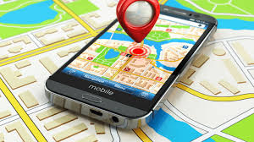
GPS Locating System
A GPS tracking unit is a navigation device, normally carried by a moving vehicle or person, that uses the Global Positioning System (GPS) to track the device’s movements and determine its location. The recorded location data can either be stored within the tracking unit or transmitted to an Internet-connected device using the cellular (GPRS or SMS), radio, or satellite modem embedded in the unit.

Slide 7
GPS Locating System(Conti)
A GPS navigation device and a mobile phone sit side-by-side in the same box, powered by the same battery. At regular intervals, the phone sends a text message via SMS or GPRS, containing the data from the GPS receiver. Newer GPS-integrated Smartphones running GPS tracking software can turn the phone into a data pusher (or logger) device. As of 2009, open source and proprietary applications are available for common Java ME enabled phones, iPhone, Android, Windows Mobile, and Symbian.

Slide 8
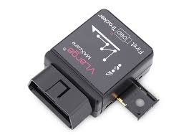
OBD Concepts
On Board diagnostics (OBD) is an automotive term referring to a vehicle's self-diagnostic and reporting capability. OBD systems give the vehicle owner or repair technician access to the status of the various vehicle subsystems. The amount of diagnostic information available via OBD has varied widely since its introduction in the early 1980s versions of on-board vehicle computers. Early versions of OBD would simply illuminate a malfunction indicator light or "idiot light" if a problem was detected but would not provide any information as to the nature of the problem. Modern OBD implementations use a standardized digital communications port to provide real-time data in addition to a standardized series of diagnostic trouble codes, or DTCs, which allow one to rapidly identify and remedy malfunctions within the vehicle.

Slide 9
Self Balancing Intro
Thus The concepts named Self balancing is mainly Implemented to avoid skidding of bikes in wet roads and also to mainly balance bikes during Accidents.
Its Main concept is to Challenge sharp Turning along with to provide flexibility to Riders and enjoy the limits of Driving

Slide 10
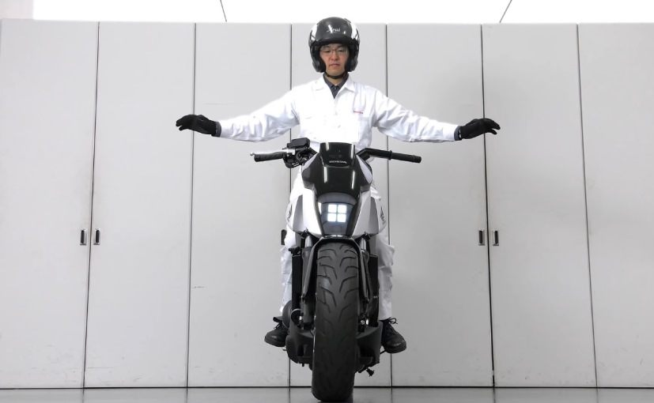
A Self Balancing Bike

Slide 11
Self Balancing Concepts
Self-balancing bicycle use sensors to detect the roll angle of the bicycle and actuators to bring it into balance as needed, similar to an inverted pendulum where it is an unstable nonlinear system and can be implemented in several ways.
It's a proposed fully-enclosed two-passenger IC engine motorbike that uses a gyroscopic stabilizing system to stay upright when stopped, or even when struck from the side in an accident

Slide 12
Prototype
The new design relies on two actuated support arms mounted behind the bike seat and laterally offset from the bike. The support arms are each directly driven by a DC motor such that they rotate around an axis parallel to the direction of forward motion of the bike , and are designed such that when the bike and the support arms are in a vertical position they do not come in contact with the ground. When the bike tilts to one side, the arm on the side of the bike forming an acute angle with the ground is actuated such that the end of the arm remains in contact with the ground until the bike is brought back to a vertical position

Slide 13
Self Balancing illustrations
Thus this model had not been completely developed and also still being developed ,thus in updated version it will be fully concluded
There are several ways f adopting these constrains so it won’t be easier so we will be catch it soon

Slide 14
Fuel Tank Indicating
In the proposed method, two Flow sensors are placed linearly, one sensor to measure the amount of fuel entering the tank and another sensor to measure the amount of fuel leaving the tank to the carburetor. The difference between the above measures gives us the amount of fuel present in the tank and it is stored in the arduino Uno microcontroller.
It actively keeps the record of the fuel entering the tank and the fuel present in the tank at any given time in the dynamic memory of the arduino and is displayed using LCD display.
If the fuel is low, the system suggests the commuter to refuel as soon as possible. If the fuel gets critically low, the system alarms the commuter to refuel immediately.

Slide 15
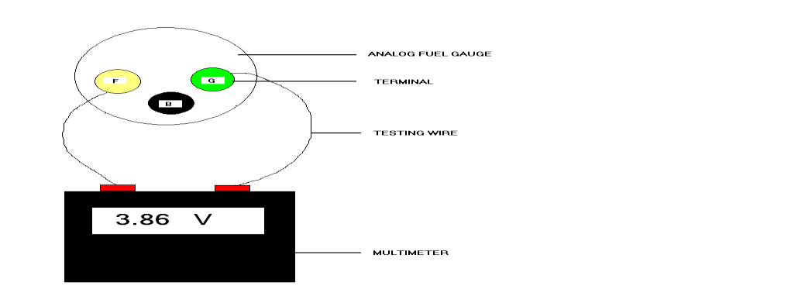
Fuel Tank Indication(Conti)
. The system has a solenoid valve which replicates the working of a carburettor of the automobile. This proposed method can identify petrol theft and is useful to people who opt for long rides. This system is designed to cut down the cost and increase the level of accuracy
The device has to be cost efficient without compromising on the accuracy of measurement. The sensor fitted has to be chemical resistant, should not vary with physical orientation, independent of shape and size of the tank

Slide 16
Fuel Tank Indication(Conti)
The implementation of the system was very smooth, easy and very effective at a very low cost compared to all other techniques. The results were stored in arduino to keep track of the efficiency. The accuracy of this system is close to 95% - 98%. The readings are unaffected by physical orientations and chemical changes of the liquid.

Slide 17
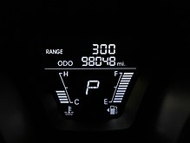
Fuel Tank Indication(Conti)
Thus from the calculated readings in the tank there is a certain algorithm according to mileage provided by the bike.
This may vary from bike to bike and also the speed they might travel. This is connected with distance mapping thus to monitor the distance to be travelled and the amount of fuel required.
Thus might send the low fuel notification to the mobile apps which may be easier to search for nearest fuel stations automatically.
A small vibrator is attached with accelerator that might decipates emergency notification with Rider.

Slide 18
Mapping Distances
The analog fuel gauge has two main units, namely the sending unit and the gauge. Here, when the fuel tank is full, resistance values decreases, current value increases and when the tank is empty, resistance values increases and current value decreases
The rear side of the analog fuel gauge has three terminals, namely B-battery, F-float, G-ground. From these terminals, voltage values are taken from the terminals-FG and resistance value is taken from the terminal-F from zero to 11 litres.
So, for a particular volt value, the corresponding litres value will be shown in digital [2]. Along with this, fuel mileage is also displayed in A/D Convertor to the corresponding fuel in the fuel tank.
Fuel mileage in vehicles refers to the relationship between the distances can be travelled by an automobile to the amount of fuel in the fuel tank

Slide 19
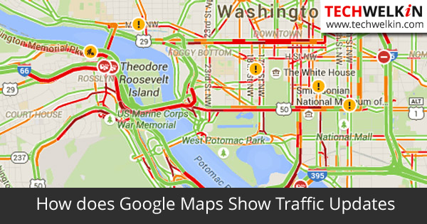
A Map With Traffic Marks

Slide 20
Distance Calculating
The A/D converter with LCD was fitted with the Analog fuel gauge of the two-wheeler and the result was successfully obtained.
The A/D converter shows the amount of fuel in fuel tank in exact litres (EX : 1.3, 1.4, 1.5 ). The A/D converter shows the exact fuel in litres only when the the fuel in the fuel tank is more then 1 litre.
The accuracy level is upto95 – 98% because the error was around ± 0.2 litres, because the fuel in the fuel tank was measured on the basis of float level in the tank and we didn’t use any other sensors
. It displays the exact litres on plane roads and shows error value on slope surfaces.

Slide 21
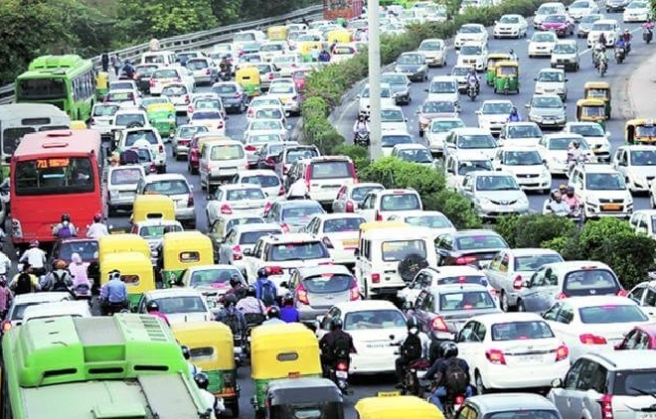
Traffic Management

Slide 22
Google’s Traffic Management
Google Traffic works by analyzing the GPS-determined locations transmitted to Google by a large number of mobile phone users.
By calculating the speed of users along a length of road, Google is able to generate a live traffic map.^{[2]}
Google processes the incoming raw data about mobile phone device locations, and then excludes anomalies such as postal vehicles which make frequent stops.
When a threshold of users in a particular area is noted, the overlay along roads and highways on the Google map changes color

Slide 23

Google Maps

Slide 24
Anonymity of location data
Google stated: "When we combine your speed with the speed of other phones on the road, across thousands of phones moving around a city at any given time, we can get a pretty good picture of live traffic conditions
Google has stated that the speed and location information it collects to calculate traffic conditions is anonymous
Google also identifies the start and end points of every trip it monitors, and permanently deletes that data so that information about where each user came from and went to remains private.

Slide 25
Locking Bikes
In Case of bike is Being Stolen, User can Locate and lock the bike via mobile application. Thus Ignition System is also controlled by Arduino. Hence a user can also provide Two Step Verification factors for bikes by invading a Security password and also a physical key. By Adding their device (i.e. Phones ,Tablets) user can add a trusted device with bike where as Two Step Authentication is not necessary in case of your own bike.

Slide 26
Tire Pressure Monitoring
Although tire pressure monitoring systems are becoming increasingly common on four-wheeled vehicles, they're still quite the rarity on two-wheelers
The one of the coolest feature is to detect the tire pressure by a small chip attached to the tire and indicate it in regular time intervals.
It can also send SOS alert to your mobile during any leakage or puncture.

Slide 27
Tyre Pressure Monitoring
The hardware end of the system consists of two sensor units, one for each wheel.
These attach to the valve stems, and contain sensors that measure not only air pressure (up to 200 psi/14 bar) but also temperature, wheel rotation and orientation.
They also each have an integrated lithium-ion battery, that should provide about 100 hours of use per charge.
Sensor data is transmitted via Bluetooth Low Energy to an app on the user's smartphone (iOS or Android), or Pebble smartwatch.
Using that app, riders can check the pressure and temperature of the air inside their tires, along with their speed and wheel alignment.

Slide 28
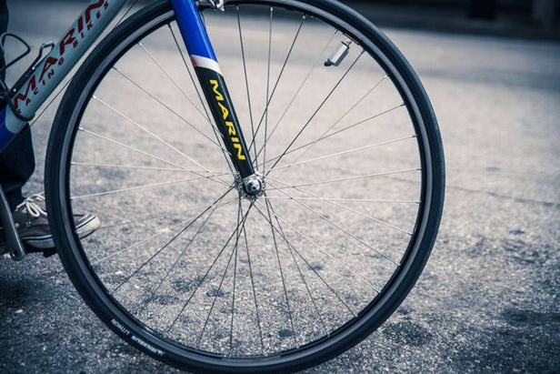
Tyre Pressure Monitoring
An optional anti-theft kit utilizes a set screw to keep the sensor units from being plucked off by passers-by.
Additionally, an "in-line fill" feature allows them to remain attached to the stems while the tires are being topped up, with the pumped-in air passing right through.

Slide 29

Servicing Bikes
This makes bikes to be Connected with the service center and provide basic details to be necessary for safety measures.
Thus there is a storage medium that stores all of the services like last service date ,total kilometers travelled and engine oil presence.
According to that survey it would send notifications to users about their bike’s condition and maintenance.

Slide 30
Servicing Modules
Thus from the clouded data stored about each bikes we can obtain all these data’s needed.
These modules would alert those service centers as well the biker to make up a full check up.
Thus it would avoid seize engines

Slide 31
Emergency Button
This a new feature attached to bike that is similar to self balancing system that will ensure bike’s stability.
Thus in case occurs any accident and there may be any crises in stability of bike then it would alert family and friends
This system consists of sensors connected to bike’s fuel tank that may occur when any large amount of pressure occurs it would trigger the sensor.
Thus An Alert message will be sent to the number provided at Emergency Scenario.

Slide 32
Network of Bikes
Thus using WiFi we can be able to connect between bikes during long road trips
Thus we can make sure that all of the riders are in a correct way and also able to make contact between them
In Network it may be easy to find all of their’s speed , location ,etc.
The main cncept behind this is to be Safe and also to make all those data confidential

Slide 33
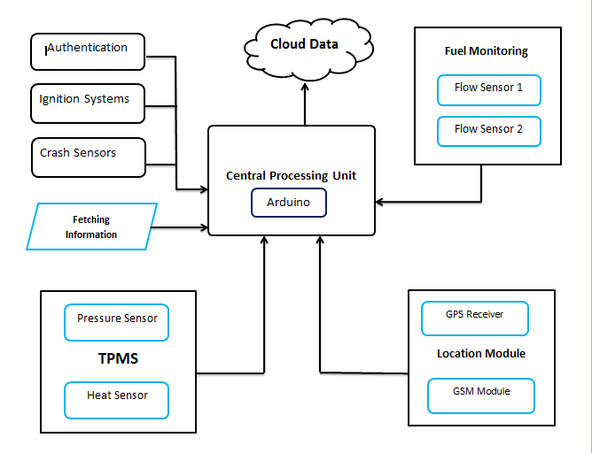
Block Diagram

Slide 34
In Future
Autonomous Breaking: It is concept that is arising in our module these are developed by Ultrasonic Sensors or Infrared Sensors that would apply brakes in case of any obstacles that is very closer to our bikes while driving.

Slide 35
Machine Learning
Thus Making CPU more powerful we can teach bikes to make sharp turnings that would record those events each and every time we pass through it and it would finally conclude the Angles and speed necessary for that turning and at one time they would drive in an efficient manner Autonomously. Implementing this is only at developing Stages; therefore in future we can make a CPU Autonomously drive a bike between provided locations.

Slide 36
Benefits
Thus by installing Jammy device on your bike you are able to track and lock your bike from anywhere in the world
The most important the fuel amounts present in tanks are monitored periodically and thus the distance that our vehicle will travel can be identified by its mileage.
Tire pressures are monitored frequently and the pressure drop out and overheating will be indicated.
If there is any Sudden Pressure leak out then the buzzers will go on indicating the puncture.

Slide 37
Benefits(contd)
Providing Two Step Authentication to bikes makes it harder to steal. In case of stolen, they could be locked by Mobile Application.
In case of any Accident, The CPU will autonomously send notification to your Respected ones (i.e. Friends or family members) with your Current Location.
Gyroscopic Sensors that are connected which would alert you in maintain the stability.

Slide 38
Conclusion
Thus the given app will surely full fill the users satisfaction which will be user friendly in android platform
It uses less battery and has very less storage.
One can also backups ones data like travelling history , fuel amount and also service Needed.
It is useful to detect accidents and send emergency messages to their family.

Slide 39
Conclusion
This device Works in an efficient manner which will allow user to ride safely. The Data will be secured. Its Graphical User interface is friendly and less data charges will apply. Many Applications can interface through it where it can be easy in both Android and iOS platforms.

